Slide 1
Decision Tree

Slide 2
What We’ll Cover
What is a decision tree?
How does it learn?
Decision Tree parameters

Slide 3
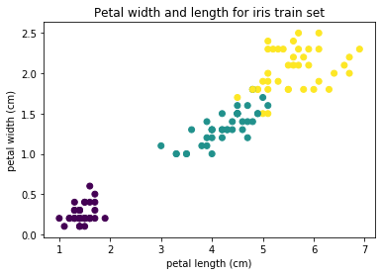
What is a decision tree?
Made up of nodes and leafs
At every step make a comparison and a decision, until you reach a solution
Notes:
Photo: https://www.flickr.com/photos/107442568@N08/12547327134

Slide 4
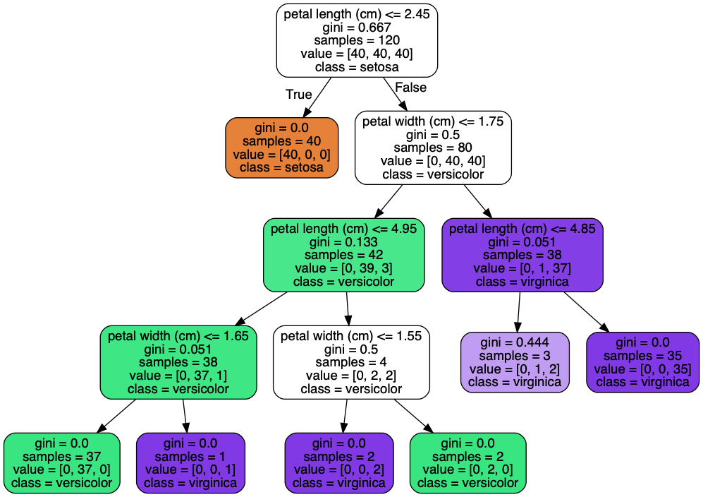
What is a decision tree?
Made up of nodes and leafs
At every step make a comparison and a decision, until you reach a solution
Node
Leaf
Notes:
Photo: https://www.flickr.com/photos/107442568@N08/12547327134

Slide 5
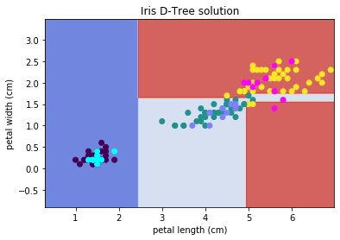
What is a decision tree?
Made up of nodes and leafs
At every step make a comparison and a decision, until you reach a solution
Notes:
Photo: https://www.flickr.com/photos/107442568@N08/12547327134

Slide 6
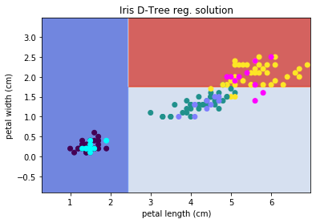
What is a decision tree?
Made up of nodes and leafs
At every step make a comparison and a decision, until you reach a solution
Decisions are orthogonal to each other
Orientation matters
Notes:
Photo: https://www.flickr.com/photos/107442568@N08/12547327134

Slide 7
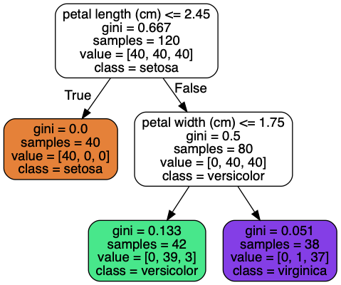
What is a decision tree?
Made up of nodes and leafs
At every step make a comparison and a decision, until you reach a solution
Decisions are orthogonal to each other
Does not depend on feature scale
Notes:
Photo: https://www.flickr.com/photos/107442568@N08/12547327134

Slide 8
What is a decision tree?
Decision criterion
Values
Show distribution of each class in leaf/node
Samples
Number of samples for training in each node
Notes:
Photo: https://www.flickr.com/photos/107442568@N08/12547327134

Slide 9
How does a decision tree learn?
How does it decide on what the decision threshold is?
Tries to find the purest nodes / cleanest split
Impurity measures
Gini
Entropy
Notes:
Photo: https://p0.piqsels.com/preview/75/886/497/4480j35547m45663a3pm5fmsvd.jpg

Slide 10
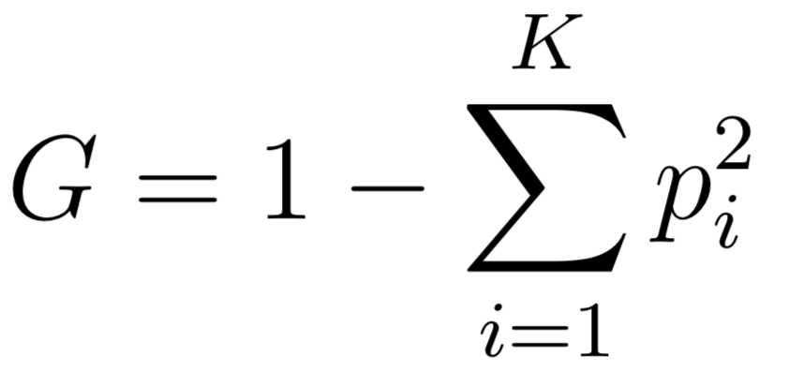
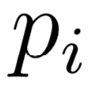
How does a decision tree learn?
How does it decide on what the decision threshold is?
Tries to find the purest nodes / cleanest split
Impurity measures
Gini (lower better) fraction of class i in the node
Notes:
Photo: https://p0.piqsels.com/preview/75/886/497/4480j35547m45663a3pm5fmsvd.jpg

Slide 11
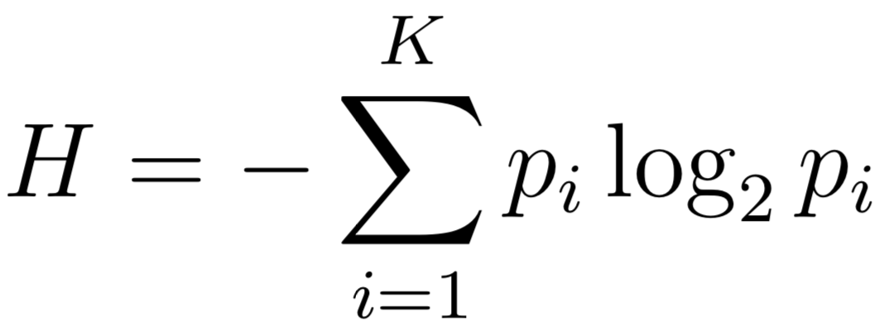
How does a decision tree learn?
How does it decide on what the decision threshold is?
Tries to find the purest nodes / cleanest split
Impurity measures
Gini
Entropy
Notes:
Photo: https://p0.piqsels.com/preview/75/886/497/4480j35547m45663a3pm5fmsvd.jpg

Slide 12
How does a decision tree learn?
How does it decide on what the decision threshold is?
Tries to find the purest nodes / cleanest split
Impurity measures
Gini vs Entropy
Both generally lead to similar results (use also changes based on algorithm)
Notes:
Photo: https://p0.piqsels.com/preview/75/886/497/4480j35547m45663a3pm5fmsvd.jpg

Slide 13
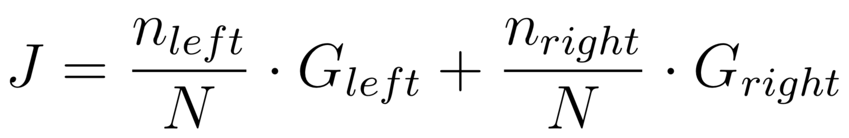
How does a decision tree learn?
Cost function (CART)
only 2 children per node (other algorithms can produce more)
Greedy splitting
The best split at each point is used, it doesn’t go up and down nodes and reverse decisions
Notes:
Photo: https://p0.piqsels.com/preview/75/886/497/4480j35547m45663a3pm5fmsvd.jpg

Slide 14
How does a decision tree learn?
How does it decide on the leafs/nodes?
At each step takes subset of features to use test splits
Best vs random split
Best more computationally expensive, can also lead to overfitting (greedy)
Random selects a random feature from the subset and finds best split
Notes:
Photo: https://p0.piqsels.com/preview/75/886/497/4480j35547m45663a3pm5fmsvd.jpg

Slide 15
Decision tree parameters
Max features (number of features to consider for choosing to find test splits on)
SKLearn randomly permutes features at each step too
Best vs random
Notes:
Photo: https://www.flickr.com/photos/107442568@N08/12547327134

Slide 16
Decision tree parameters
Maximum tree depth
Minimum leaf size
Minimum samples required to split
Maximum number of leafs
Minimum required impurity improvement to split
(all used for regularization)
depth
Notes:
Photo: https://www.flickr.com/photos/107442568@N08/12547327134

Slide 17
Decision tree parameters
Class probability
Traverse tree breakdown proportion of samples in final leaf node that come from each class (e.g. bottom left proportions are (0, 39/42, 3/42)
Notes:
Photo: https://www.flickr.com/photos/107442568@N08/12547327134

